Slide 1
Predicting best location for new café in Singapore

Slide 2
Problem
Success of new café chains depends greatly on the location which determines number of potential customers in the area as well as the amount and level of competition in the area
This study will help owners to understand the level of risk in terms of competition that would be associated with the potential gain in number of customers in each planning area

Slide 3
Data Acquisition and cleaning
Data of planning areas from Wikipedia, referenced from the Department of Statistics Singapore in 2018.
Venue locations, likes, ratings and category from Foursquare dataset using it’s API
Features such as translated names, area size and region were dropped
Cleaned data contained 8 Features

Slide 4
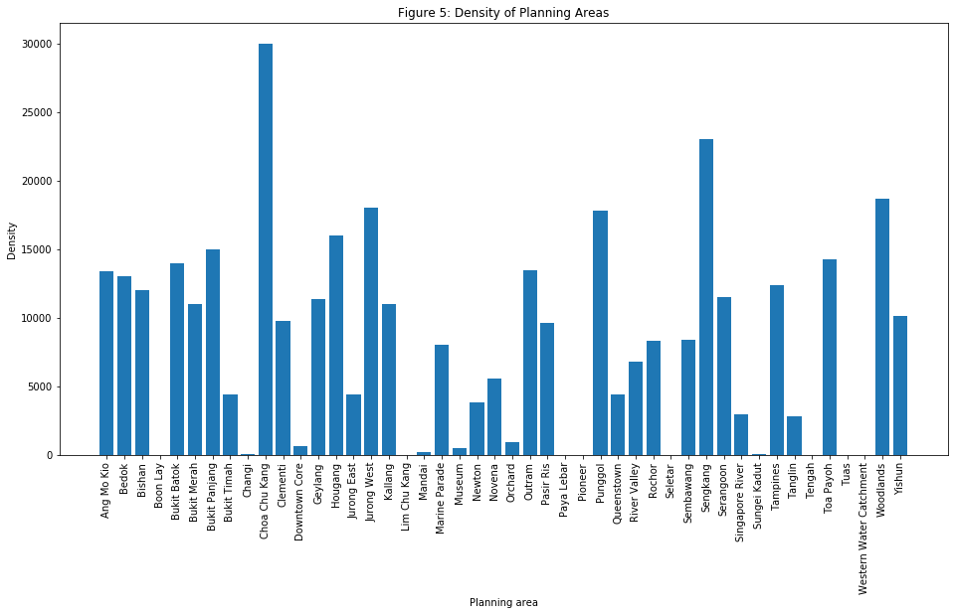
Population density of planning areas

Slide 5
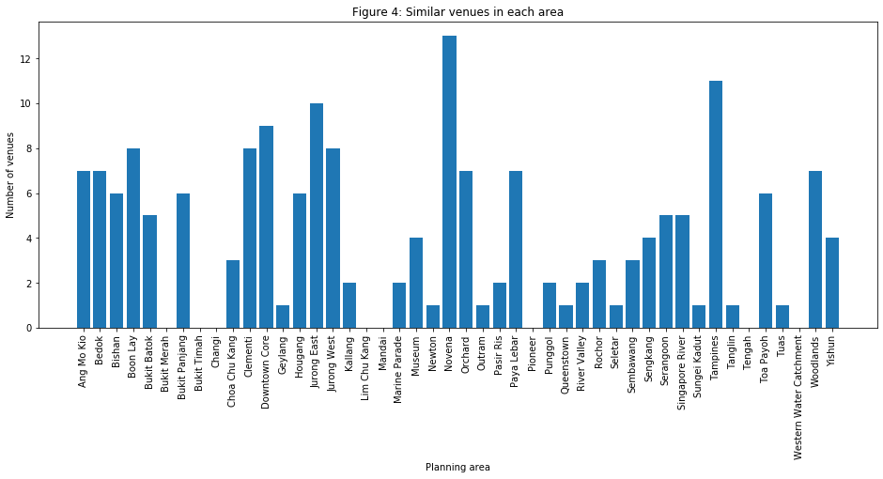
Similar Venue count in each area

Slide 6
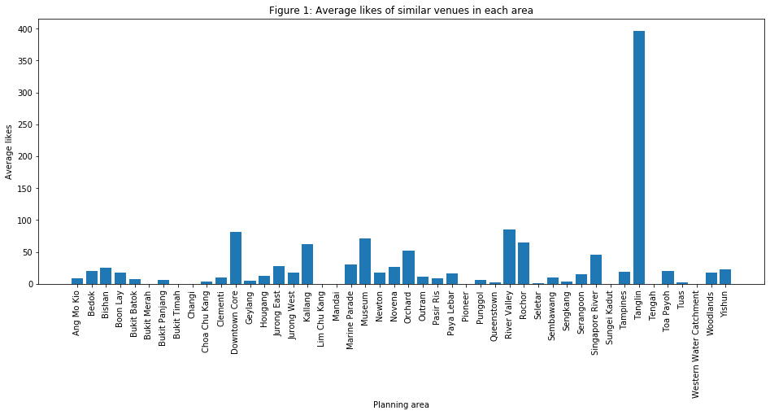
Average likes in each area
Tanglin has only 1 venue, PS café,
which is very well known resulting
in an unusually high amount of likes

Slide 7
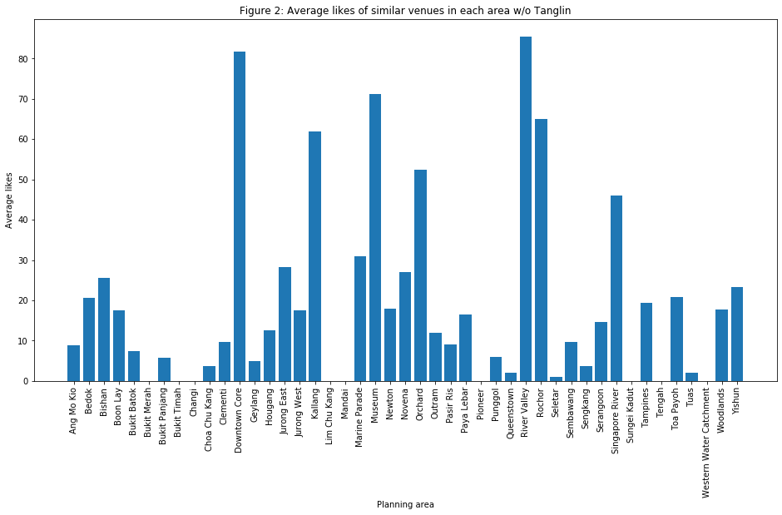
Average likes in each area without Tanglin

Slide 8
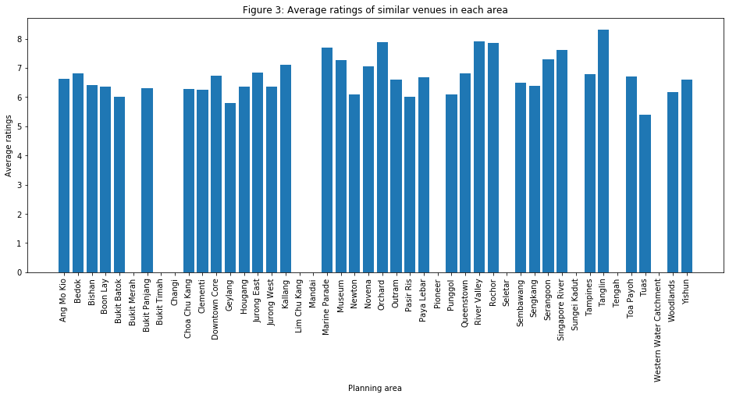
Average ratings in each area

Slide 9
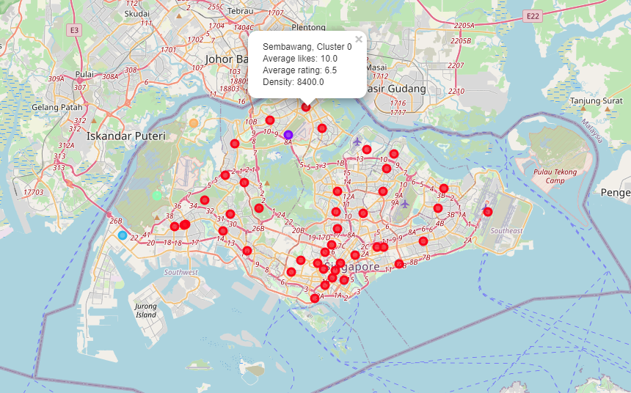
Clustering of planning areas
Areas clustered using K-means algorithm based on the different venue categories nearby its location
Number of clusters set to 5
Most planning areas are similar and fall into cluster 0

Slide 10
Conclusion
For an area with no competition, Bukit Merah would be ideal with a population density of 11,000 per square kilometre
If a small amount of competition is acceptable, Chua Chu Kang would be the most ideal.
Going forward more ideal data can be collected such as venue earnings, venue patronage and foot traffic can be obtained to make comparisons more accurate and realistic. Moreover, additional locations can be explored within each planning area to provide a more comprehensive comparison.

